Slide 1

Exploring
#5 Loopback Module

Slide 2
Loopback
LoopBack is a highly-extensible, open-source Node.js framework that enables you to create dynamic end-to-end REST APIs with little or no coding, access databases and also Incorporate model relationships and access controls for complex APIs (http://loopback.io).
Installation
$ npm install -g loopback-cli
Check version
$ lb -v

Slide 3
Create App
On terminal, type:
$ lb
What's the name of your application?
lin_loopback
Enter name of the directory to contain the project:
lin_loopback
Which version of LoopBack would you like to use?
3.x (current)
What kind of application do you have in mind?
api-server
Go to project directory:
$ cd lin_loopback
Run the application:
$ node .
Web server listening at: http://localhost:3000
Browse your REST API at http://localhost:3000/explorer

Slide 4
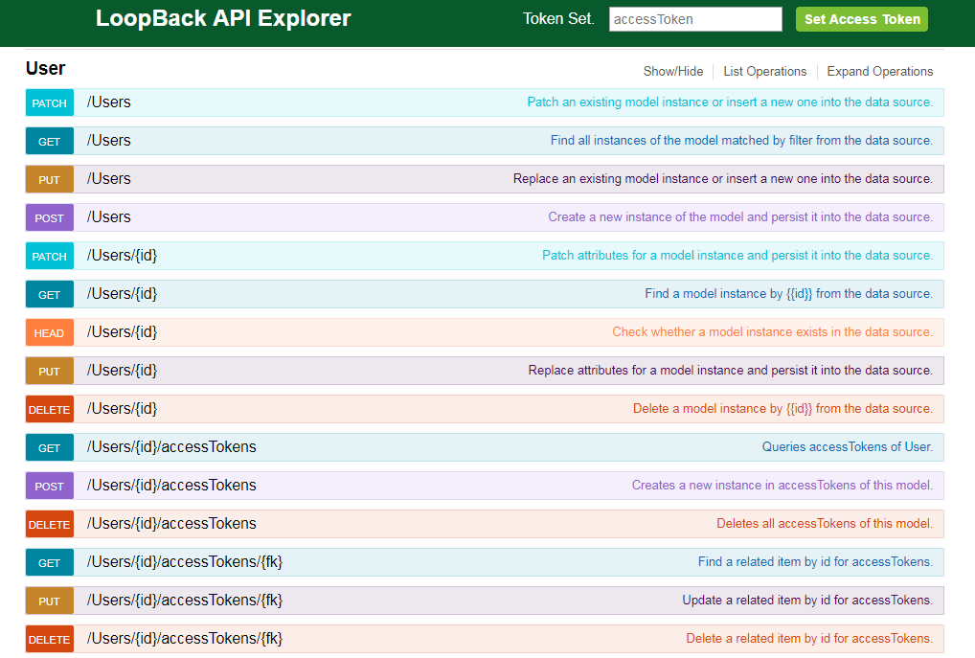
http://localhost:3000/explorer

Slide 5
Set App
By default, we must set token for accessing loopback API. To use its API without any authentication, do these steps:
Go to projectDir/server/boot/authentication.js
Comment this line: server.enableAuth();
Try to POST at POST/Users!
{
"email" : "lintang@purwadhika.com",
"password" : "123456"
}
Try to post custom data, then GET at GET/Users!

Slide 6
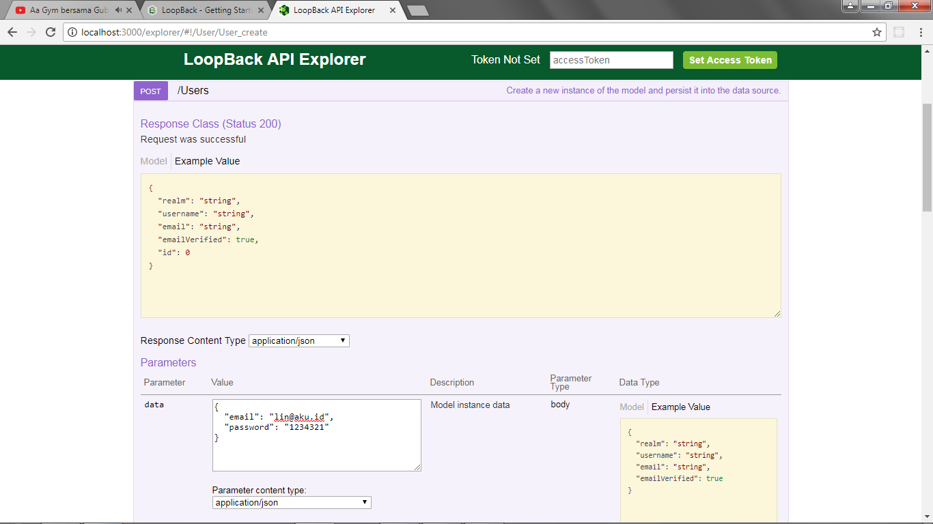
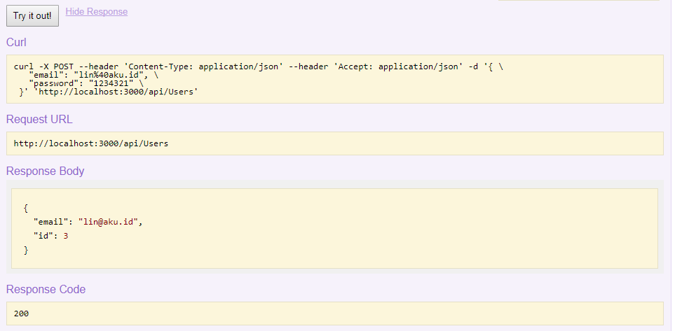
POST
By default, “email” & “password” have to be declared correctly!
It will response an “id” automatically!
You can type other JSON data after “email” & “password” too.

Slide 7
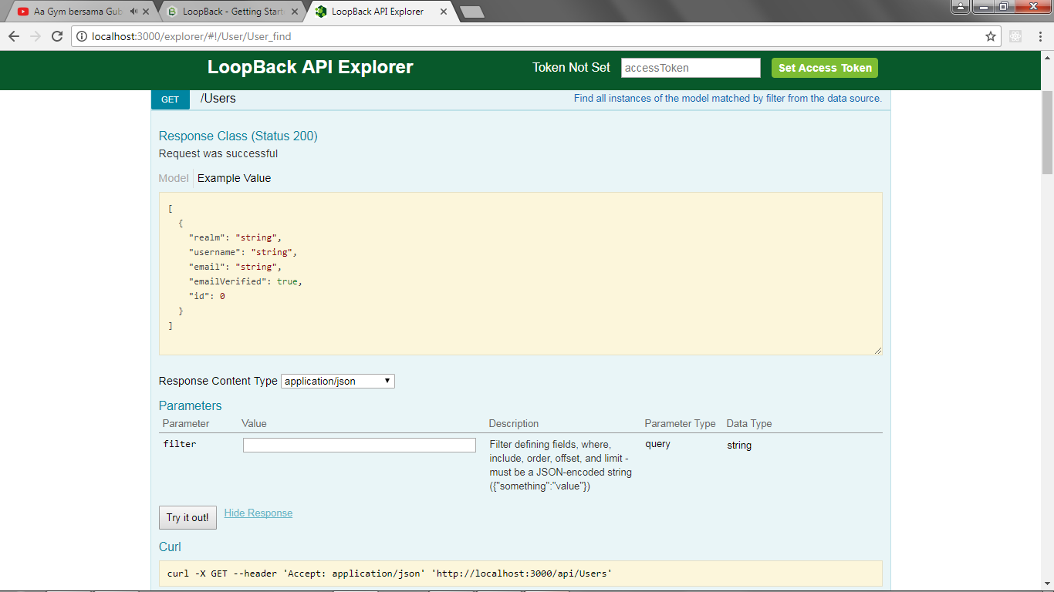
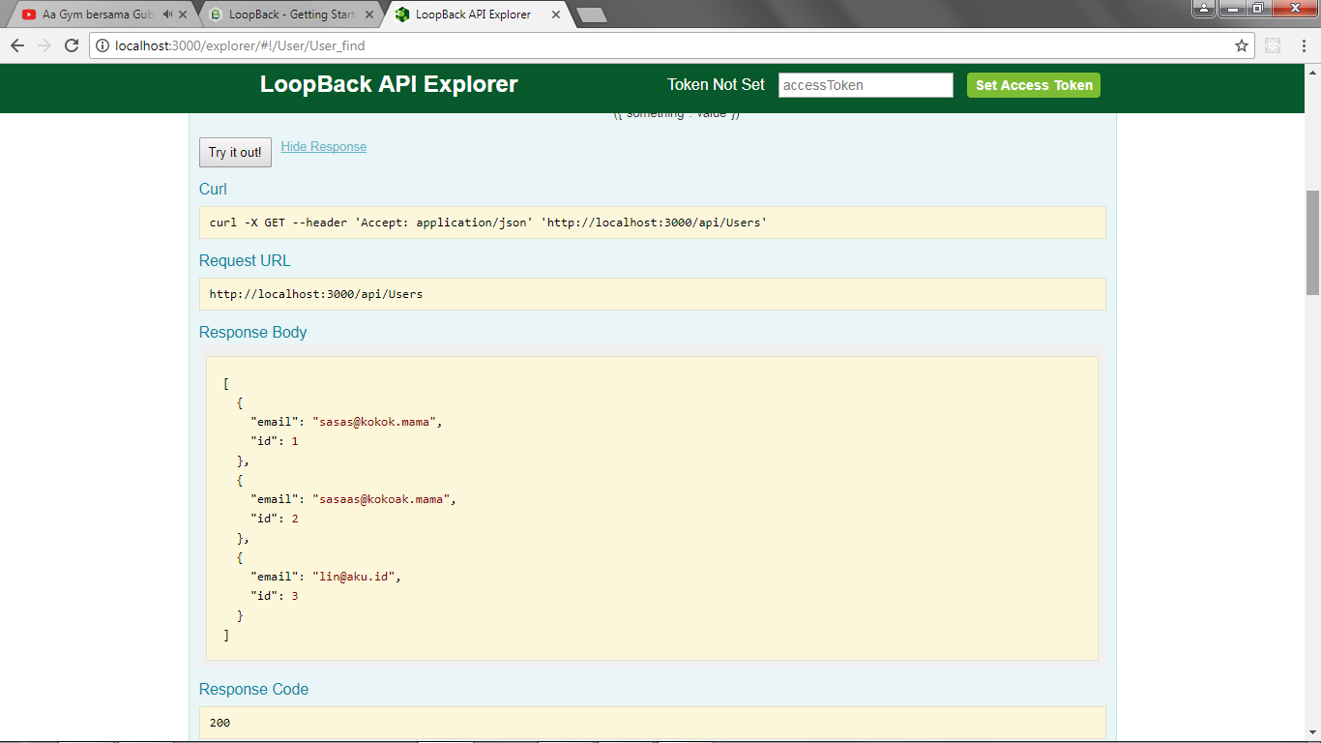
GET
It will response an “id” & hide the “password” automatically!

Slide 8

A powerful GUI platform to make API development faster & easier, from building API requests through testing, documentation & sharing.
Postman has features for every API developer: request building, tests & pre-request scripts, variables, environments & request descriptions, designed to work seamlessly together.
Download from getpostman.com
Try to POST & GET
with POSTMAN!

Slide 9
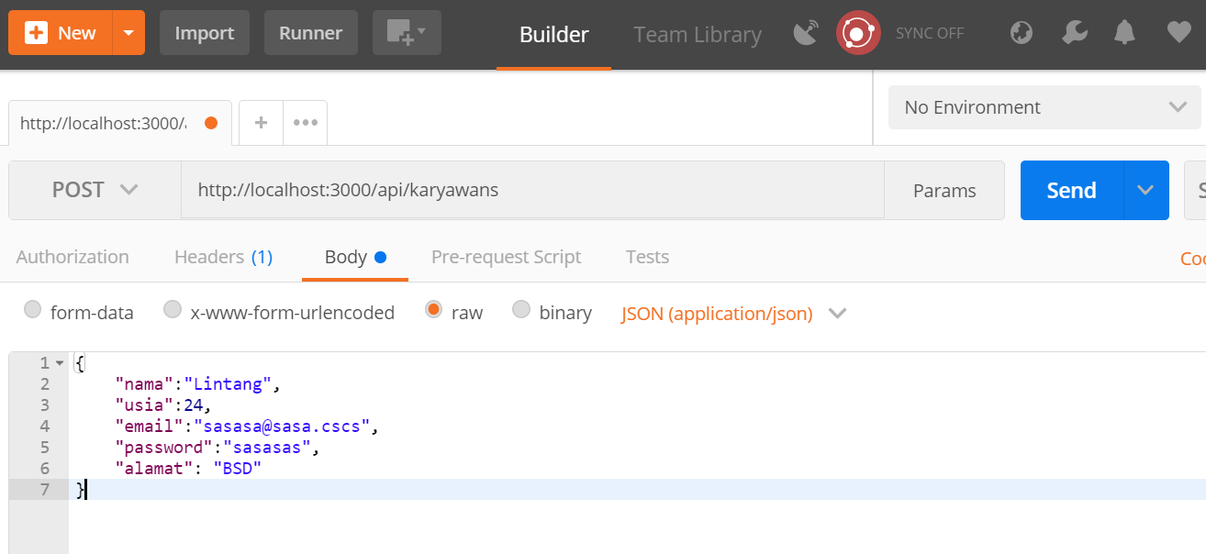
POST with POSTMAN
Set Header Request to
Content-Type: application/json

Slide 10

GET with POSTMAN

Slide 11
Create Model
On directory project, type:
$ lb model
[?] Enter the model name: karyawan
[?] Select the data-source to attach person to: db
[?] Select model`s base class (PersistedModel)
[?] Expose person via the REST API? Yes
[?] Custom plural form (used to build REST URL):
[?] Common model or server only? Common
Let's add some person properties now.
Enter an empty property name when done.
[?] Property name: id
[?] Property type: (Use arrow keys) number
[?] Required? (y/N) y
Property “id” is a must! After done, try to run its app via terminal: $ node .

Slide 12
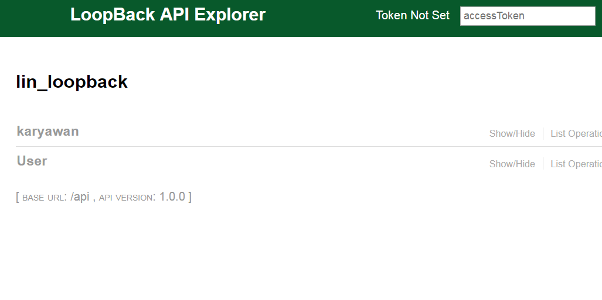
Create Model
Try to POST & GET
with POSTMAN!

Slide 13
POST with POSTMAN
Set Header Request to
Content-Type: application/json

Slide 14
GET with POSTMAN

Slide 15
Exploring
#5 Loopback Module

